Slide 1
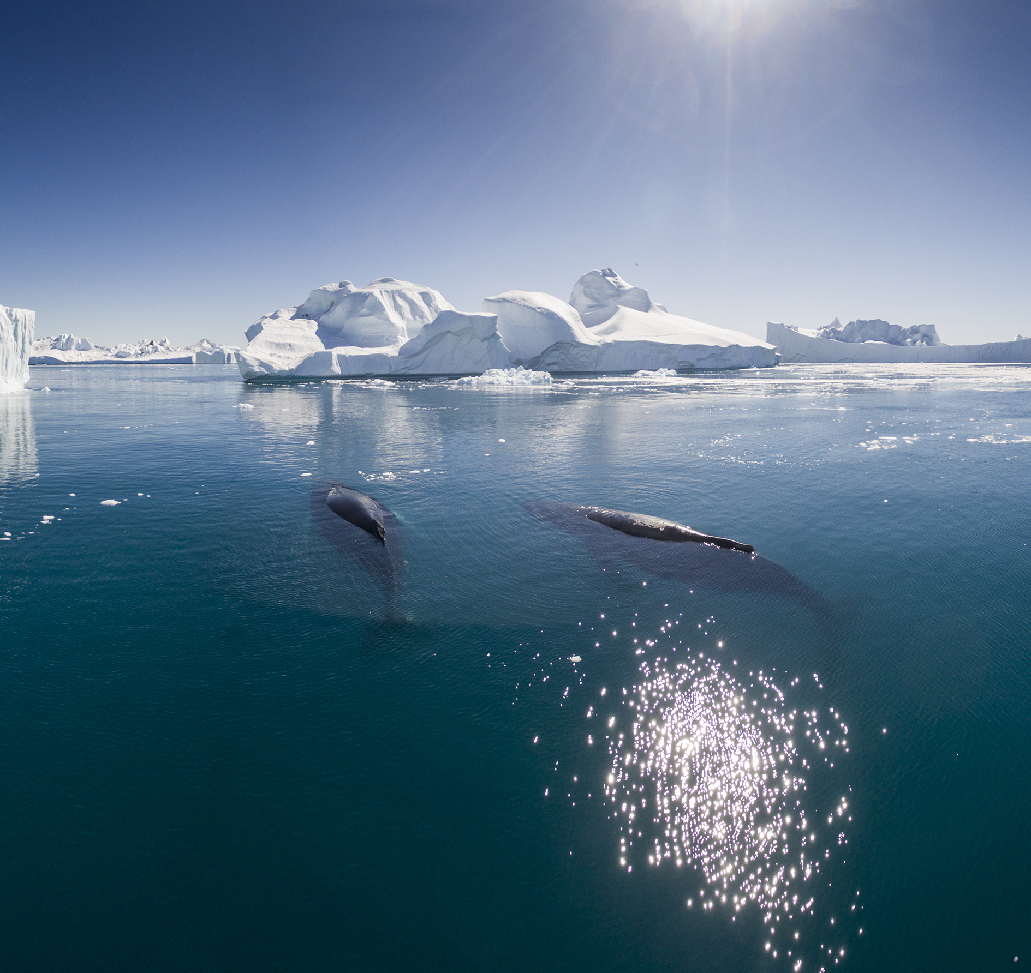
ClimateWins: Machine Learning Results Presentation
Olufemi Ige
December 2025
CareerFoundry: Data Analytics & Machine Learning
Notes:
Good [morning/afternoon], everyone. Thank you for joining me today.
This presentation focuses on how machine learning can be used to predict pleasant and unpleasant weather conditions across Europe.
I’ll be sharing insights from my work with historical climate data, where I evaluated different supervised machine learning models to understand which approaches are most effective for climate-related decision-making.
Climate prediction matters because it directly supports planning, risk management, and long-term adaptation strategies for communities, governments, and nonprofit organizations like ClimateWins.

Slide 2

Project Objective & Background
Predict pleasant/unpleasant weather across 18 European stations.
Dataset spans late 1800s–2022 with daily temperature and climate metrics.
Goal: Evaluate ML models and recommend the most accurate approach.
Notes:
The main objective of this project was to evaluate and compare different machine learning models for weather prediction.
The analysis uses a large historical dataset collected from 18 weather stations across Europe, covering daily observations from the late 1800s up to 2022.
This long-time span allows us to study both short-term variability and long-term climate trends.
Accurate climate modeling is increasingly important because it helps organizations anticipate extreme weather, improve preparedness, and make evidence-based decisions in the face of climate change.

Slide 3
Project Hypotheses
H1: Temperature metrics strongly influence weather pleasantness classification.
H2: Stations with stable seasonal patterns achieve higher prediction accuracy.
H3: Nonlinear models (ANN) outperform linear/simpler models (KNN, DT).
Notes:
Based on the project goals and prior research, I tested three main hypotheses.
First, I hypothesized that temperature-related variables—such as mean, minimum, and maximum temperature—are strong predictors of whether a day is classified as pleasant or unpleasant.
Second, I expected that weather stations with more stable and consistent seasonal patterns would produce higher prediction accuracy.
Third, I hypothesized that nonlinear machine learning models, particularly artificial neural networks, would outperform simpler models because climate data often contains complex, nonlinear relationships.
These hypotheses help guide both model selection and interpretation of results.

Slide 4
Dataset, Integrity, Bias Risks
Dataset
Source: European Climate Assessment & Dataset (ECA&D)
Integrity Considerations
Historical measurement gaps and device inconsistencies
Data standardized using StandardScaler for uniformity
Bias Risks
Data imbalance between pleasant and unpleasant labels
Geographic variability across weather stations
Notes:
The dataset used in this analysis comes from the European Climate Assessment & Dataset, which is a well-established and widely used climate data source.
However, like most real-world datasets, it comes with potential bias risks.
These include historical measurement gaps, differences in recording instruments over time, imbalance between pleasant and unpleasant weather labels, and geographic variability between stations.
To reduce technical bias and ensure fair comparisons across models, I standardized the data using feature scaling.
Maintaining data integrity is especially critical in climate research, because biased or poorly processed data can lead to misleading conclusions.

Slide 5
Optimization & Feature Processing
171 climate features standardized for modeling.
Focus features: mean/min/max temperature across 18 stations.
Optimization concepts applied: loss functions, backpropagation, learning rates.
Local/global minima visualized in temperature variation patterns.
Notes:
Before applying machine learning models, the dataset was processed and optimized.
In total, 171 climate-related features were standardized to ensure that no single variable dominated the learning process due to scale differences.
The analysis focused primarily on temperature features—mean, minimum, and maximum values—since they are closely tied to human perceptions of weather pleasantness.
Key optimization concepts such as loss functions, learning rates, and weight updates were applied, particularly in the neural network models.
Additionally, temperature variation patterns were visualized to better understand the structure of the data and how models respond to it.

Slide 6
Supervised Learning Models Used
K-Nearest Neighbors (KNN): ~60–62% accuracy.
Decision Tree: 100% train / 94% test (overfitting).
ANN Scenario 1: 89% / 91%.
ANN Scenario 2: 94% / 93%.
ANN Scenario 3: 98% / 96% (best performing model).
Notes:
Several supervised learning models were evaluated in this project.
These included K-Nearest Neighbors, Decision Trees, and multiple Artificial Neural Network configurations.
The KNN model achieved moderate accuracy but struggled with more complex patterns.
The Decision Tree model performed extremely well on training data but showed signs of overfitting, as its test performance was lower.
The Artificial Neural Network models showed progressively better performance as model complexity increased, with later scenarios achieving strong and consistent accuracy across stations.

Slide 7
Recommended Model: ANN Scenario 3
Hidden layers: (50, 20, 10), max_iter=1000, tol=0.00001.
Highest stability across stations.
Best for nonlinear weather relationships.
Generalizes better than Decision Trees and KNN.
Notes:
Based on overall performance, Artificial Neural Network Scenario 3 is recommended as the best model for ClimateWins.
This model uses three hidden layers with 50, 20, and 10 neurons, along with a higher number of training iterations and a lower tolerance value.
It achieved the highest and most stable accuracy on both training and test data, indicating strong generalization rather than memorization.
Most importantly, this model is well-suited for capturing nonlinear relationships, which are common in climate and weather systems.

Slide 8

Summary & Next Steps
Summary
ANN Scenario 3 provides the best accuracy and generalizability.
Next Steps
Expand feature set (sunshine, radiation, humidity).
Test with cross-validation for robustness.
Apply models to real-time ClimateWins weather streams.
Notes:
To summarize, this analysis shows that machine learning—particularly artificial neural networks—can effectively classify weather conditions using historical climate data.
Among all models tested, ANN Scenario 3 provided the best balance between accuracy and generalization.
Next steps include expanding the feature set to incorporate additional climate variables such as sunshine, radiation, and humidity.
Further validation using cross-validation techniques would improve robustness, and eventually these models could be applied to real-time weather streams to support ClimateWins’ operational planning.

Slide 9
Thank You
Questions?
Contact: Olufemi Ige
feminoble8@gmail.com
Notes:
Thank you very much for your time and attention.
I welcome any questions, feedback, or discussion on this analysis or on potential future directions.
Please feel free to reach out if you’d like to follow up after the presentation.

